Slide 1

- Managing in the Digital World -
Navigating the Digital Horizon through the Foundations of Transformation
(Week #1)
University Canada West (UCW)

Slide 2

Content
1- Introduction to Digital Transformation
2- Traditional vs. Digital Enterprise Thinking
3- Key Concepts and Theoretical Frameworks
4- The Enterprise Thinking in Digital Management
5- Stages of Digital Transformation
6- The Heart of Digital Transformation
7- Reflective Practice
8- Conclusion

Slide 3
Session Objectives
Understanding Digital Transformation
Personal and Widespread Impact of Digital Transformation
Exploring Key Concepts and Frameworks
Comparing Traditional and Digital Enterprise Thinking
Understanding Strategic Digital Transformation
Reflecting on Digital Technology's Impact
Analyzing Real-world Applications

Slide 4
1- Introduction to Digital Transformation
1-1- Overview of Digital Transformation
What is digital transformation?
Why is it significant in the current business environment?
1-2- Digital Transformation Experiences
How have you personally experienced digital transformation in your life?
What examples illustrate its widespread impact?

Slide 5
2- Traditional vs. Digital Enterprise Thinking
2-1- Enterprise Thinking in Traditional Business
Strategic Management, SWOT analysis, business models, research, and surveys.
2-2- Transition to Digital
Digitization to Digital Transformation: The progression from digitization, digitalization, to digital transformation.

Slide 6
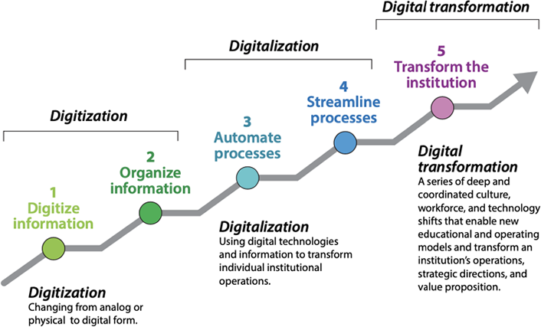
2- Traditional vs. Digital Enterprise Thinking

Slide 7
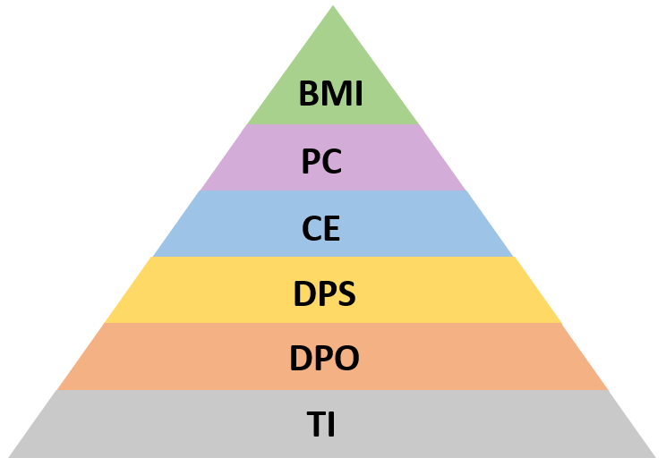
3- Key Concepts and Theoretical Frameworks
3-1- Enterprise Thinking Using the Pyramid Approach
Understanding the layers
Importance of alignment of layers
Digital Transformation Layer | Corporate Layer
Business Model Innovation (BMI) | Business Strategy Goal: Align culture and business models with digital advancements for sustainable growth.
People and Culture (PC)
Customer Experience (CE) | Corporate Execution Goal: Implement digital strategies to improve operations and customer engagement.
Digital Products and Services (DPS)
Data and Process Optimization (DPO) | Enabling Technologies Goal: Establish a strong digital foundation.
Technology Infrastructure (TI)

Slide 8
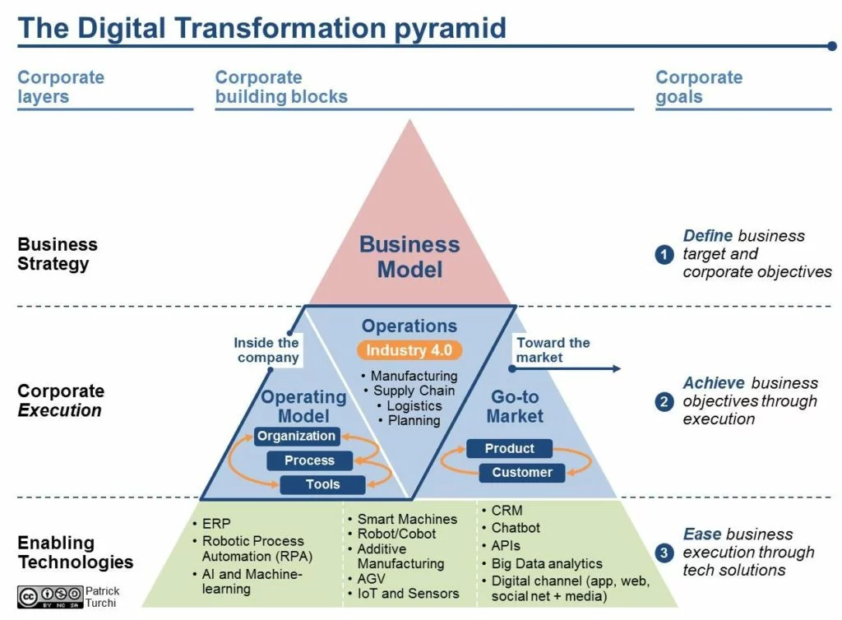
3- Key Concepts and Theoretical Frameworks

Slide 9
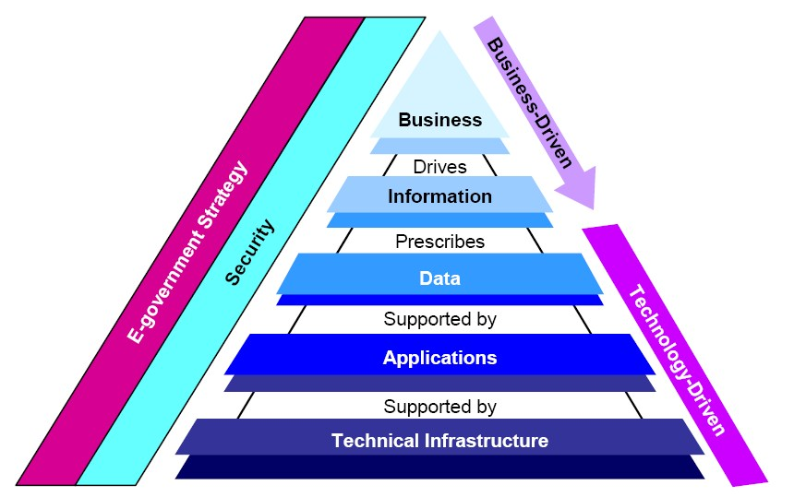
3- Key Concepts and Theoretical Frameworks
ROI, Competitive Advantage, Value Market Position, Costs
Dashboards, KPI, Performance Indicators
Data Virtualization, Big Data
Software - User interface – internal and external
Hardware, Storage, Network, Internet

Slide 10
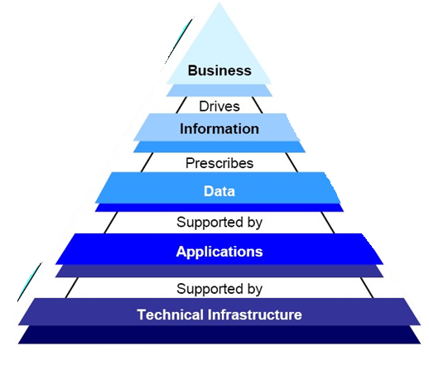
3- Key Concepts and Theoretical Frameworks
Digital
Transformation
Digitalization
Digitization

Slide 11
4- The Enterprise Thinking in Digital Management
What is ROI? How does it give Competitive Advantage? What kind of Value?
How will it impact our Market Position? How much Costs? Why do we need it? What will we learn?
What are the Dashboards, KPI, Performance Indicators? How does it make us more efficient and effective?
How do we Data Virtualization, What kind of Big Data?
What kind of Software - User interface – internal and external? How will it work? What is the user experience?
Where, how, why, what - Hardware, Storage, Network, Internet

Slide 12
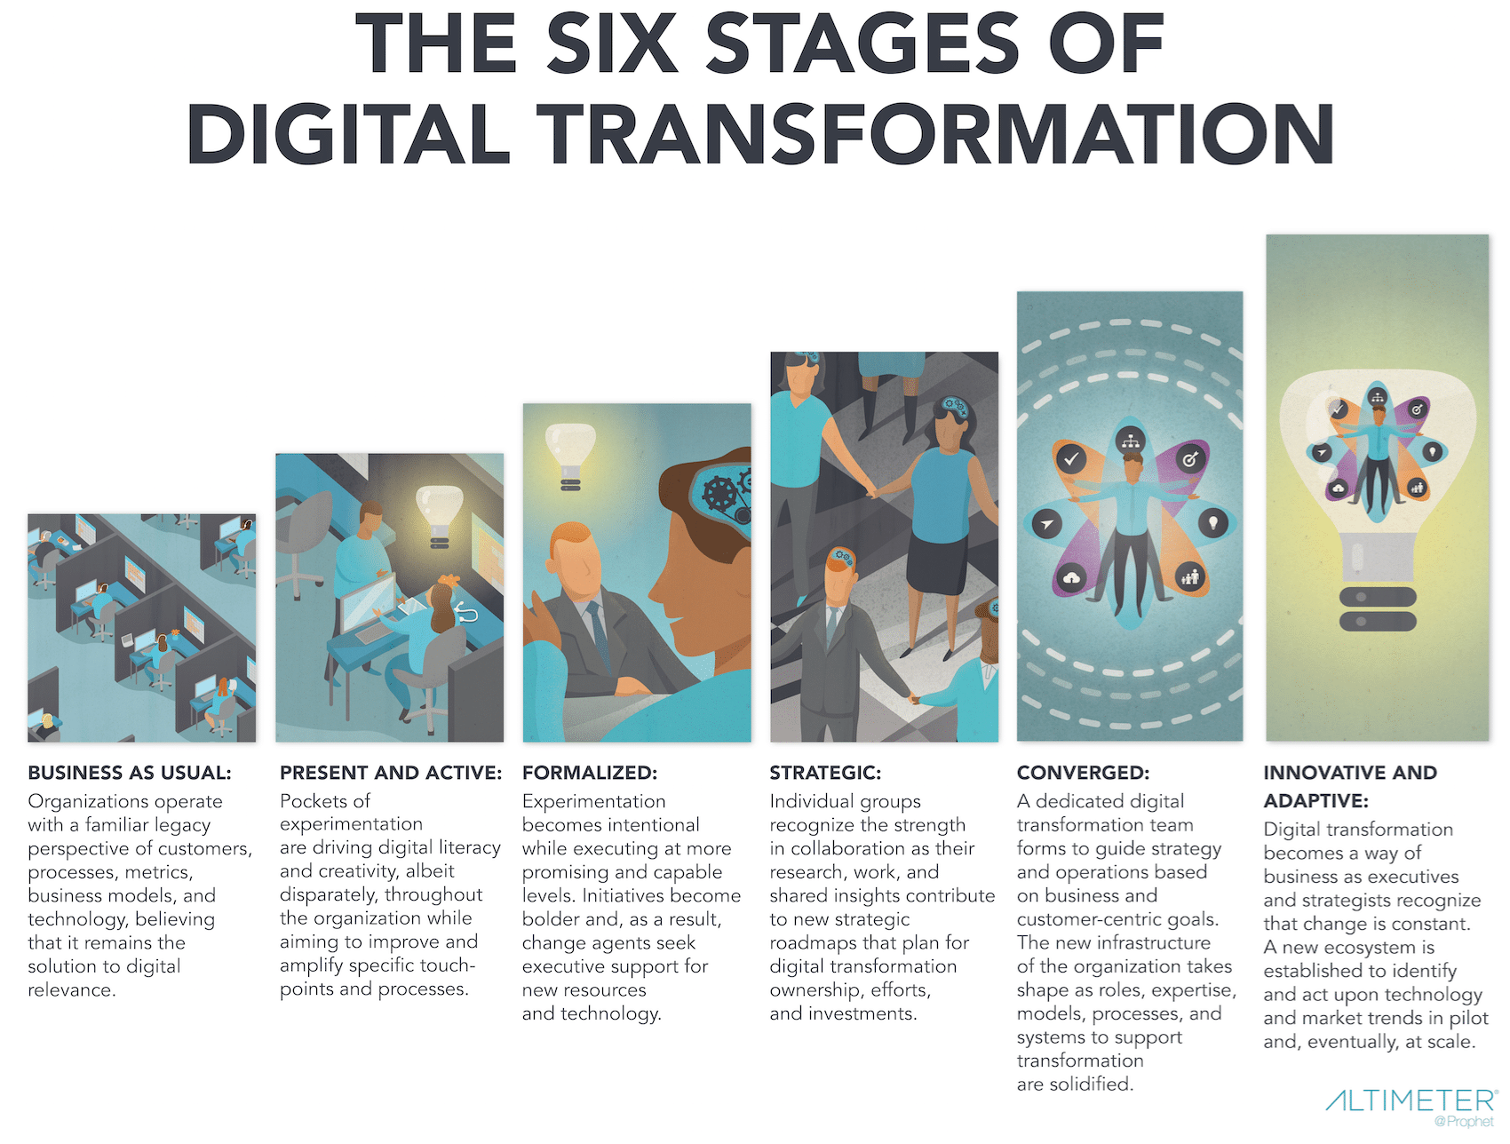
5- Stages of Digital Transformation

Slide 13
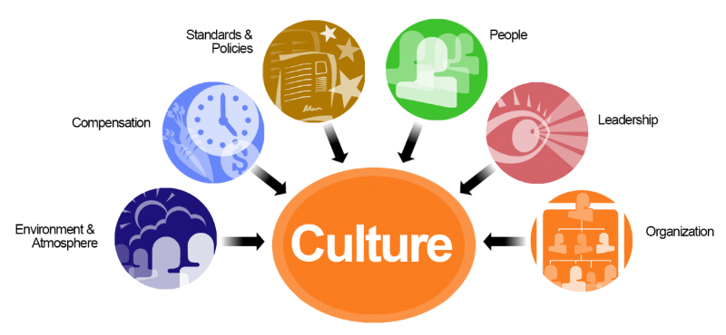
6- The Heart of Digital Transformation

Slide 14
7- Reflective Practice
7-1- Reflect on the Impact of Digital Technologies
How have mobile phones and other digital technologies transformed our lives and broader societal processes?
7-2- Industry Case Studies
Banking Industry: Mobile Banking Transformation
Retail Industry: Omnichannel Retailing
Healthcare Industry: Telemedicine and Digital Health Records

Slide 15
8- Conclusion
This session on digital transformation underscores the critical importance of adapting to digital changes to avoid obsolescence, emphasizing the need for strategic alignment of people, processes, and culture.
It highlighted the transition from traditional to digital-first strategic thinking and the application of strategic frameworks like the Enterprise Thinking Pyramid and Porter’s Value Chain. The discussion also recognized the profound personal and societal impacts of digital technologies, stressing the importance of agility, continuous learning, and innovative leadership in navigating the digital landscape effectively.

Slide 16
Main References
1- Leading Digital: Turning Technology into Business Transformation by George Westerman, Didier Bonnet, and Andrew McAfee
2- Digital Transformation: Survive and Thrive in an Era of Mass Extinction by Thomas M. Siebel
3- Building Digital Culture: A Practical Guide to Successful Digital Transformation by Daniel Rowles and Thomas Brown

Slide 17

Thank you for your participation!
Your journey in learning and exploration doesn't end here.
Feel free to contact me if you have any questions or feedback.
Dr. Davood Wadi
Full-time Faculty
University Canada West (UCW)
Vancouver, BC
davood.wadi@myucwest.ca

